Slide 1
Striking Parallels
Between
The JFK and 9/11 Cover-ups
Barbara Honegger, M.S.
JFK Conference -- Dallas, TX
Nov. 20, 2020

Slide 2
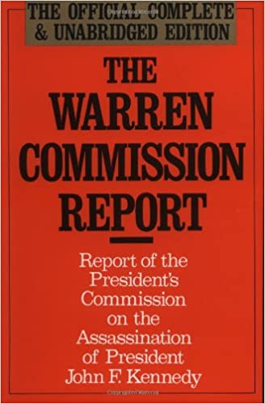
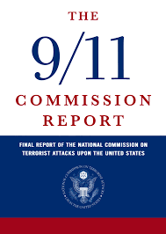
The Official Cover-Up Reports

Slide 3
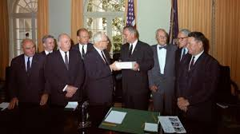
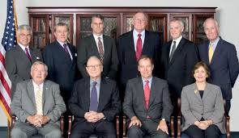
Warren Commission 9/11 ‘Warren Commission’

Slide 4
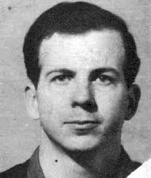
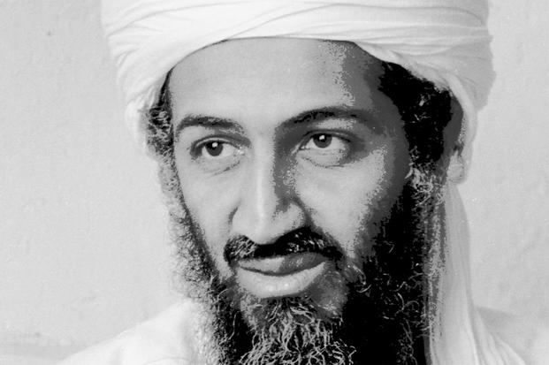
The Official Patsies

Slide 5
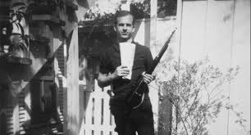
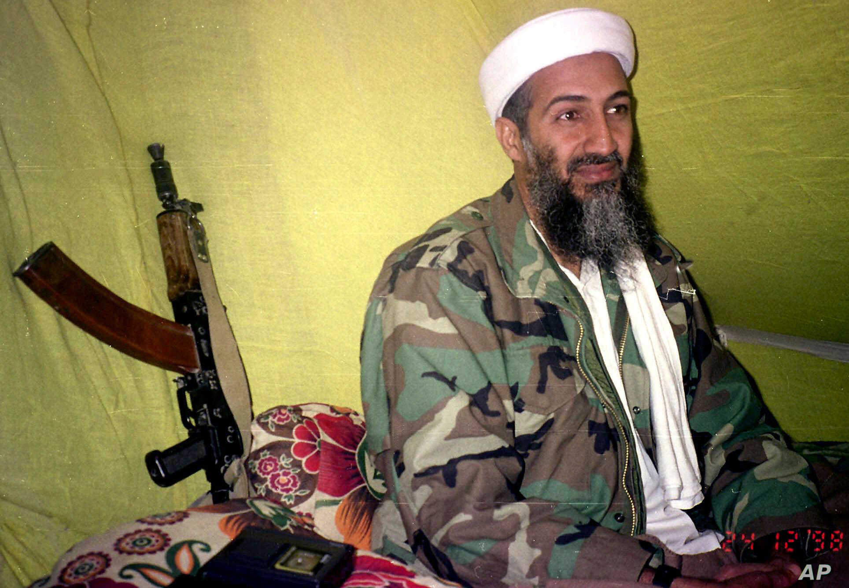
. . . With Their Rifles

Slide 6

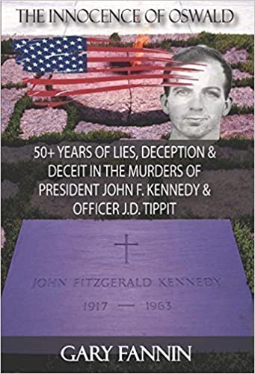
Lee Harvey Oswald Didn’t Do It

Slide 7
Osama Bin Laden Didn’t Do It
* He said He didn’t do it
* The ‘Confession’ video was a fake
* He was never on the FBI’s ‘Most Wanted’ List for 9/11, just for the Africa Embassy bombings
* The FBI’s chief investigative spokesperson:
“The FBI has no hard evidence linking bin Laden to 9/11.”

Slide 8
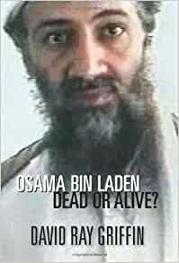
Bin Laden Died in Dec. 2001

Slide 9
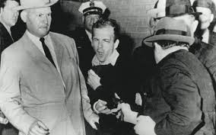
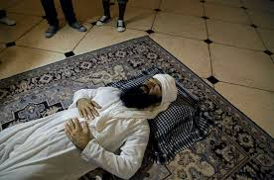
Killing The Patsies

Slide 10
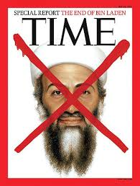
The Obligatory TIME Covers

Slide 11
New Official Patsies Were Needed
KSM, The New ‘Mastermind’, and ‘The 9/11 Five’
Still in Guantanamo and Still No Trial

Slide 12
Yet Another Next Layer In of the 9/11 Patsy Onion:
The Saudis
The ‘28 Pages’, J.A.S.T.A, and
The 9/11 Victims’ Family Members’ Lawsuit
Against Saudi Arabia

Slide 13
The Saudis Also Didn’t Do It
15 of the 19 Alleged Hijackers Were Saudis
BUT ...
No evidence any of the Alleged Hijackers got on any of the 9/11 planes:
‘No Evidence of 19 Muslim Hijackers’
by Elias Davidsson
http://aldeilis.net/truth/chapter-3.pdf

Slide 14
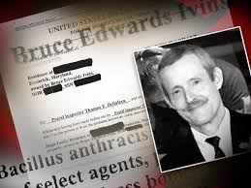
The ‘Other’ 9/11 Patsie
Bruce Ivins – Alleged “Anthrax Killer”
He Also Didn’t Do It

Slide 15
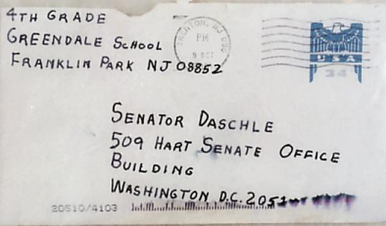
Anthrax Attacks Petition to Congress – Oct. 15, 2020 https://www.lawyerscommitteefor9-11inquiry.org/lawyers-committee-anthrax-petition/

Slide 16
Why the Truth About the Anthrax Attacks Matters
The GOVERNMENT SAYS They were an INSIDE Job
Anthrax Links to The Day OF 9/11 =
Government Admission 9/11 ITSELF was an INSIDE Job

Slide 17
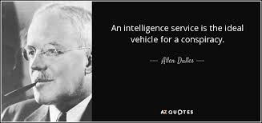
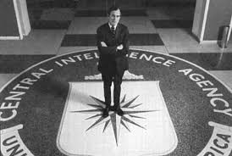
The Real Masterminds
JFK Assassination 9/11

Slide 18
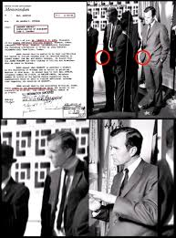
The Bush Connection
JFK Assassination
‘Bush and The JFK Hit:
Where was Poppy on
November 22, 1963?’
By Russ Baker
HTTPS://WHOWHATWHY.ORG/2013/09/16/PART-1-MR-GEORGE-BUSH-OF-THE-CENTRAL-INTELLIGENCE-AGENCY/

Slide 19
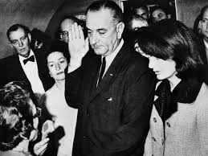
This Would Have Been Bush Sr.
If The Reagan Assassination Attempt
Had Succeeded

Slide 20
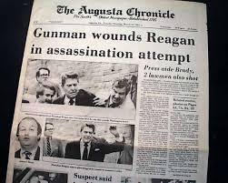
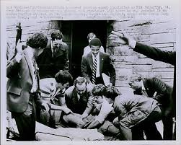
March 30, 1981
Bush Was NOT Made Acting President
Under the 25th Amendment

Slide 21
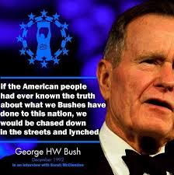

Slide 22
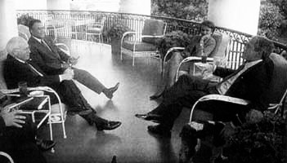
President George W. Bush, Prince ‘Bandar Bush’,
Vice President Cheney and NSC Adviser Condolezza Rice
Celebrating on The White House Balcony
Sept. 13, 2001

Slide 23
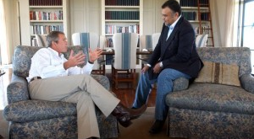
George W. Bush and ‘Bandar Bush’ at Bush’s Texas Ranch

Slide 24
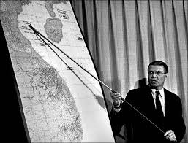

The Motive: War & War Profits

Slide 25

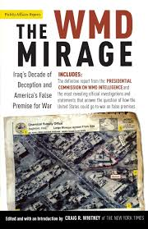
Gulf of Tonkin ‘Attack’ ‘Iraqi WMD’
1964 2001

Slide 26
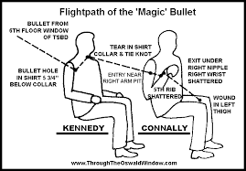
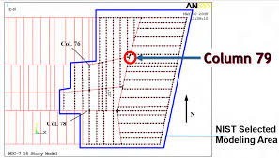
Official Story Impossible Absurdities
The Magic Bullet and Magic Column 79

Slide 27
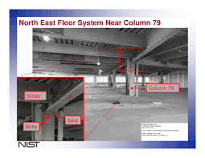

Magic WTC7 Column 79

Slide 28
2020 Breakthrough
The University of Alaska Hulsey Report on WTC7
‘World Trade Center 7 Building Did Not Collapse Due to Fire: University of Alaska [Hulsey] Report’
May 20, 2020
https://canada.constructconnect.com/dcn/news/others/2020/05/world-trade-center-7-building-did-not-collapse-due-to-fire-report
’Seven’ Video Trailer
Architects & Engineers
for 9/11 Truth
https://www.youtube.com/watch?v=FL9CCZFuDFY&feature=youtu.be

Slide 29
57 and 19 Years On -- Where Are We ??
9/11 Truth Movement Legal Actions:
Lawyers’ Committee for9/11 Inquiry
9/11 Victims’ Family Members’ Lawsuit
Reopening of UK 9/11 Coroner’s Inquest
Guantanamo ‘9/11 Five’ Tribunal
An Immense Opportunity

Slide 30
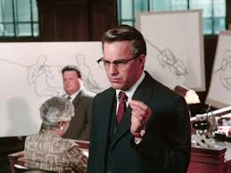
We Need a ‘JFK’ for 9/11 Truth
But It Won’t Be by Oliver Stone

